Slide 1

Indo German Family Office Summit 2025
A rising number of successful family-owned SMB and industries look for a takeover due to lack of a successor
A great opportunity to take over a successful German business
Joint-ventures can expand the European business to Asia and serve both markets in a joint cooperation
This is an exclusive event designed for representatives of family offices from India and Germany who look for joint ventures or mutual take-overs.
Notes:
Autumn 2025; 2. Where: Mannheim (preferred)
We may run a precursor road show before to get more attention for the main event.
We may also choose Stuttgart, that is a great place for Mittelstand (home of Mercedes, Bosch, Porsche etc.) – Here we just had the event with TV9.

Slide 2

Indo-German Family Office Summit
Participants:
ca. 10 Indian family offices;
Hand-selected German companies who have interest in Indian focus investment or joint-ventures
Business Sector
Manufacturing aligned with MII program
Organisers
Germany: BVMW India: CII (Rajasthan)
Support
Chambers of Commerce, GTAI, BVMW
Selected law firms in international business
Indian diaspora organisations
GIIC (Germany-India Innovation Corridor, TIE Germany)
Venue:
City of Mannheim is requested (awaiting confirmation)
Alternative venue: Frankfurt Airport
Full day closed event with dinner
Succeeded by visits to selected firms
Participation fee (suggested)
Indian delegates: 3 Lakh INR (ca. 3’000EUR)
German delegates: 3000EUR
Indian family office meet German manufacturing firms who look for successors (take-over) or joint-venture
A rising number of successful family-owned SMB and industries look for a takeover due to lack of an successor
A great opportunity to take over a successful German business
Joint-ventures can expand the European business to Asia and serve both markets in a joint cooperation
Notes:
Main organiser of the event will be on German side the BVMW (https://bvmw.de/en ) the German association of small and mid-size businesses. 40% of German SMB are member of the organisation. Delegation lead on Indian side will be CII Rajasthan.
We shall be supported by the Chamber of Commerce Germany and by German Trade and Invest (GTAI, https://gtai.de) ).

Slide 3
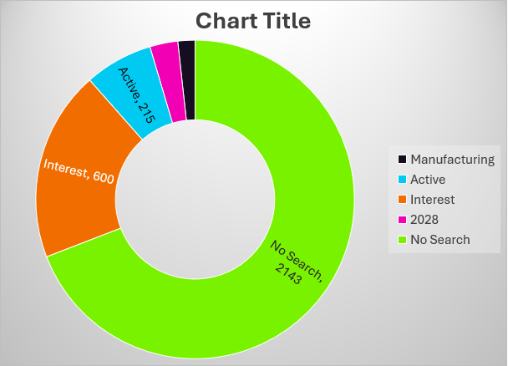
Fact-Sheet 2024 Successor
A rising number of successful family-owned SMB and industries look for a takeover due to lack of a successor
Europe has a demographic problem:
Population gets older (Median Germany: 47 years)
Lack of qualified work forces, mainly:
craftsmanship (blue collar jobs)
Manufacturing and industrial production
health care
German Investment Bank Study ‘24
3.1 Million SMB in Germany
300’000 in manufacturing
54’000 actively look for successor
215’000 indicate interest in transfer
Estimate for 2028: 600’000 will be in the need to find a successor

Slide 4

Event Timeline
(tentative timeline, exact dates need to be agreed with local support partners on availability of venue and dignitaries)
Timeline
July 2025
Axel+BVMW: Mailing to members of BVMW who have signalled an interest in finding successors or international JV
CII: Onboarding interested Indian family offices
September 2025
Series of Web conferences to introduce the family offices with the potential candidates
November 2025
One Family office day in Germany
Round trip Germany to visit selected companies based on matchmaking result
Who should attend?
This is an exclusive event designed for representatives of family offices from India and Germany who look for joint ventures.
Leaders of SMB who look for acquisition or expansion to either market are welcome but need to be approval by the board.
Indian investors who look for acquisition or joint-venture with German SMB in manufacturing or supply chain
We welcome press and media to cover the event.

